Slide 1
IaC Support for On Premise and Managed Services
Lusaka Oct/Nov 2023
David Fry - INFITX

Slide 2
Overview of IaC
IaC has been built with a modular approach to support:
Different Kubernetes Distributions
Tested with k3s, microk8s and eks
Different Cloud Vendors Including Bare Metal
Tested with AWS and Bare Metal
Different Applications on top of Kubernetes
Tested with Mojaloop and PM4ML

Slide 3
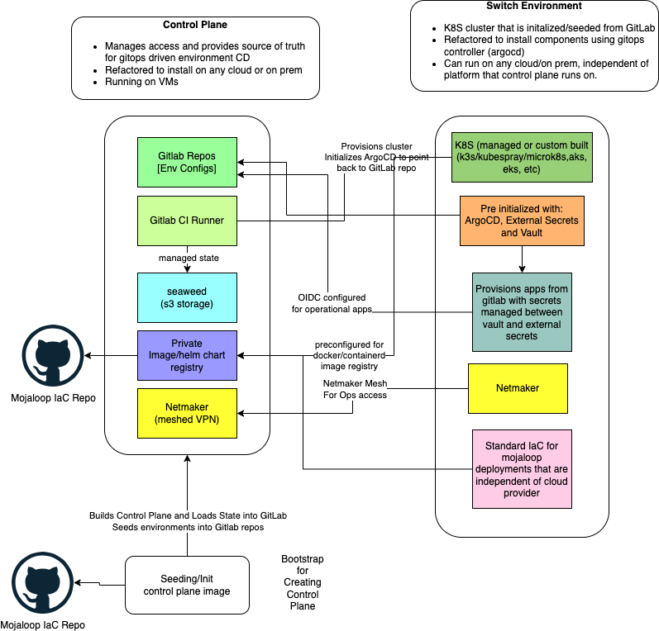

Slide 4
The Modules of IaC
Base K8S Infra Module
Enables flexibility of deployment dependency configurations.
I.e. to support both lightweight developer deployments and full redundant resilient production deployments.
Ansible K8S Deployment Module
GitOps Deployment Module

Slide 5
Base K8S Infra Module
Cloud/on prem specific
Terraform Module Based
Creates either base VM/networking/security (on prem/DIY cloud) or essential components for managed k8s
Generates inventory file for ansible to be used in the next part of the pipeline (cluster provisioning)

Slide 6
Kubernetes Cluster Module
Ansible module-based approach to create kubernetes cluster
Driven off of inventory file created in the base infra module but is independent of the actual base infra module used.
Options include kubespray, microk8s, k3s, eks, aks, etc
1st step is to provision k8s cluster
2nd step is to install argocd, netmaker and external secrets into newly created cluster. These tools are preconfigured to connect to gitlab.
Seeds root app for argo to pull app details from gitlab
After this module, no access to the cluster needed from gitlab, all pipelines are done via gitops pull from the cluster controller (argocd)

Slide 7
GitOps Module - Runs on any K8S Cluster
Terraform Module that builds out the configuration files that are used to drive gitops-based deployment of apps.
Creates foundational apps along with appropriate secrets created via external-secrets Gitlab and Vault Cluster Secret Stores.
external-dns
certificate-manager
longhorn storage (can be replaced with ceph/etc)
vault and vault-config-operator
stateful-resources
Istio for service mesh and ingress and egress gateways
Output is directory structure with appropriate config files (no secrets) in the environment gitlab repo
This repo is read by root app deployed in previous ansible module and this controls all deployments.

Slide 8
GitOps Module - Runs on any K8S Cluster
The resulting GitOps deployment provides the base components for security, ingress control and monitoring needed by any application.
The last level of modularization is the layering in of mojaloop or PM4ML that plugs into the underlying base components.
IP whitelisting, JWT Validation and MTLS support is provided out of the box via Connection Manager, Keycloak and Istio.
Near future plans for adding Ory Stack as last component in order to provide consistent authorization across the APIs and Web Applications.

Slide 9
IaC PI-23 Highlights
Added microk8s as a 2nd K8s option (as well as K3s)
Added EKS as a 3rd K8s option
Added Istio (K8s native option as ingress gateway)
Added Keycloak option as identity provider and JWT issuer
Using Istio + Keycloak to control API access i.e, NO WSO2!!!
Added K6s instance as option for cluster deployments to facilitate the load testing effort (+perf characterisation workstream)
Added support for PM4ML deployments using same IaC components as Mojaloop deployments.
Finalizing modules for bare metal deployments.
Built out modules for running Managed Database services as drop in configuration replacement for in-cluster databases. Tested with RDS
Added argocd post-sync GP test execution via ttk jobs
Connection Manager integrated with keycloak and istio as well as new vault

Slide 10
Current Work and Next Steps
Discussions with different community members to start building out managed Kubernetes modules for AKS and OCI.
Finish callback integration with Connection Manager, almost code complete. Will then be ready for PM4ML-based end to end testing
K6S module is built to integrate with performance testing initiative, this needs to be configured and tests run against k8s cluster based install of Mojaloop.
Finish the managed Kafka implementation on AWS and build out managed services on different cloud providers
Complete the testing of the bare metal module to test end to end on on premise deployment.

Slide 11
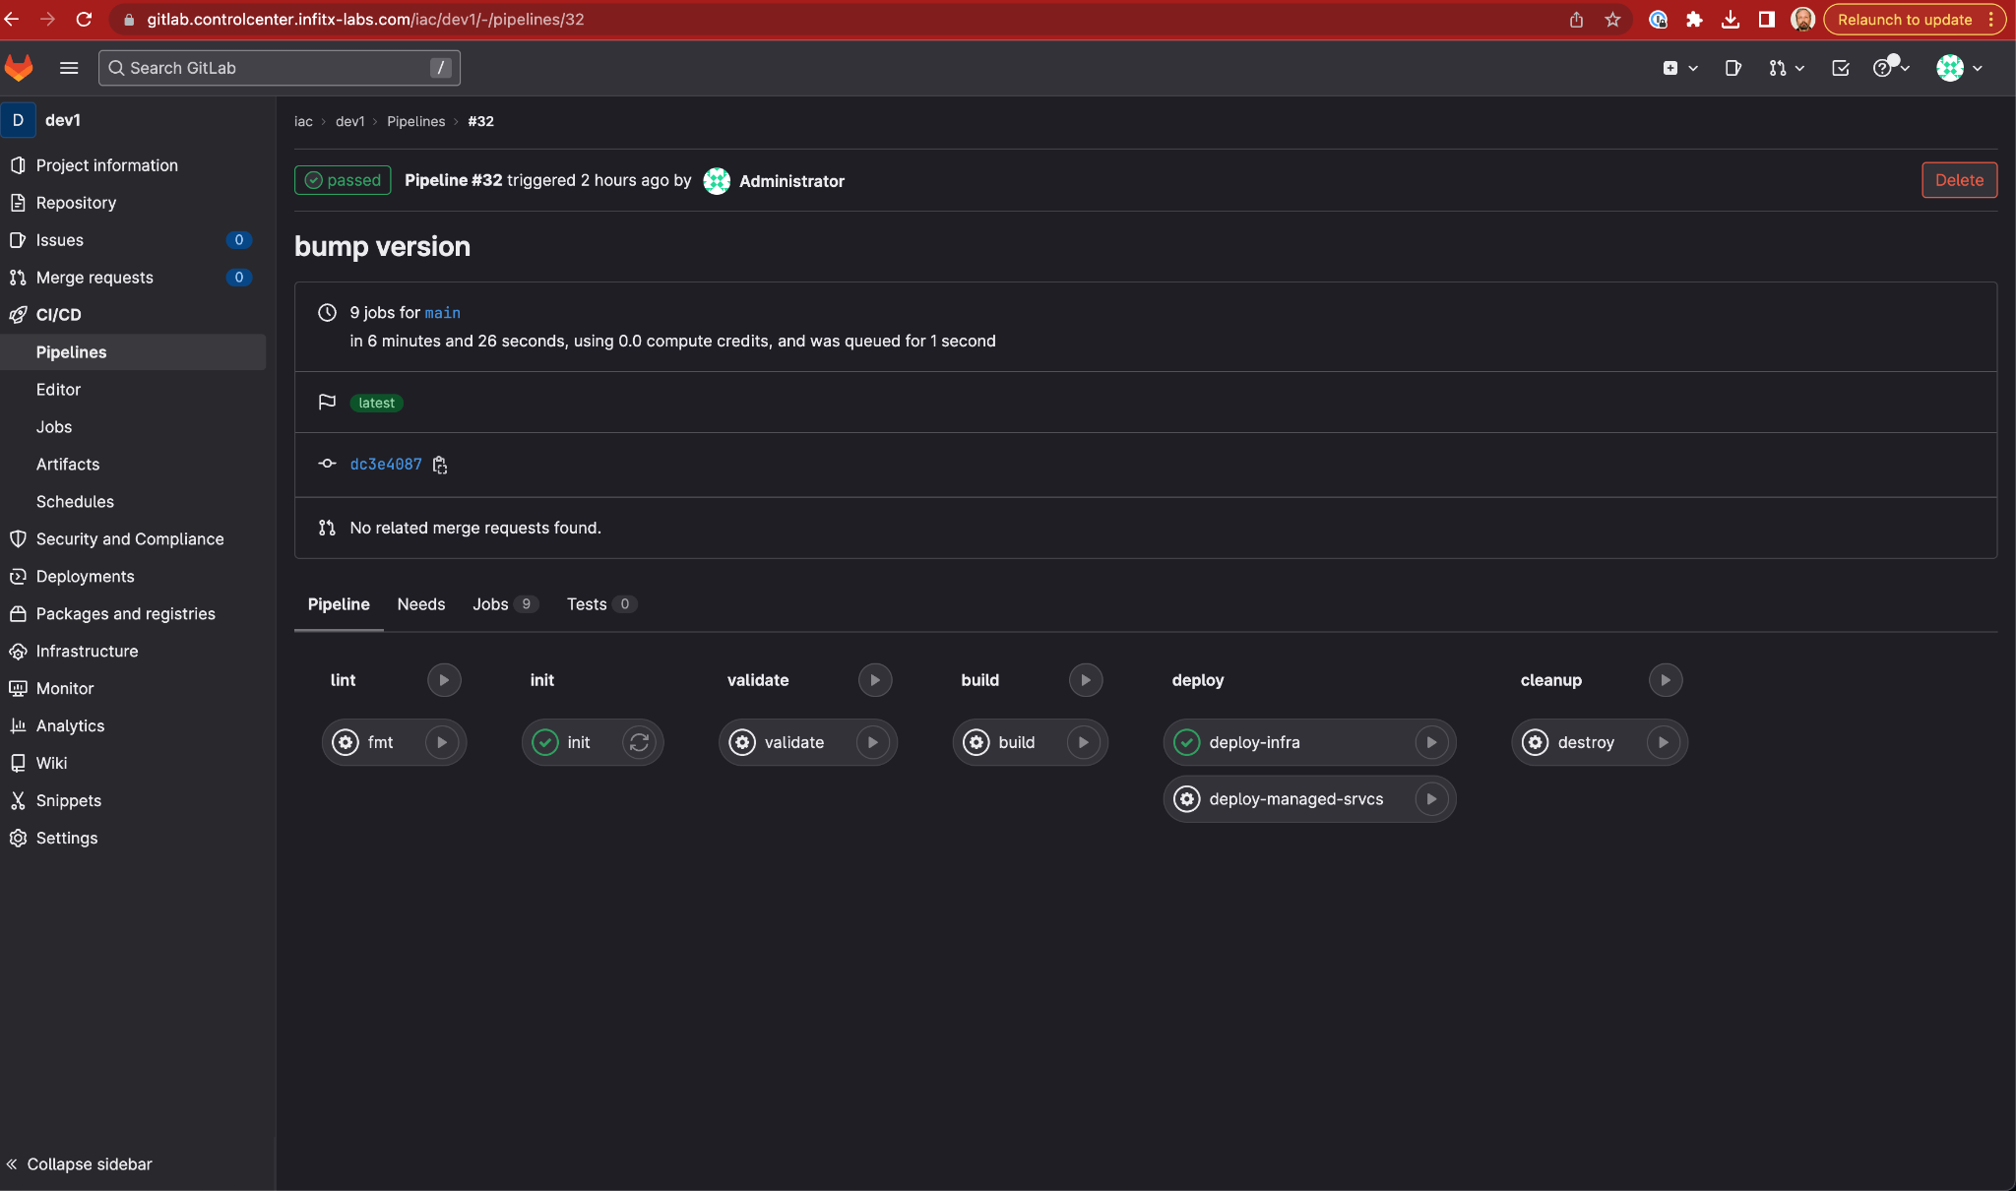

Slide 12
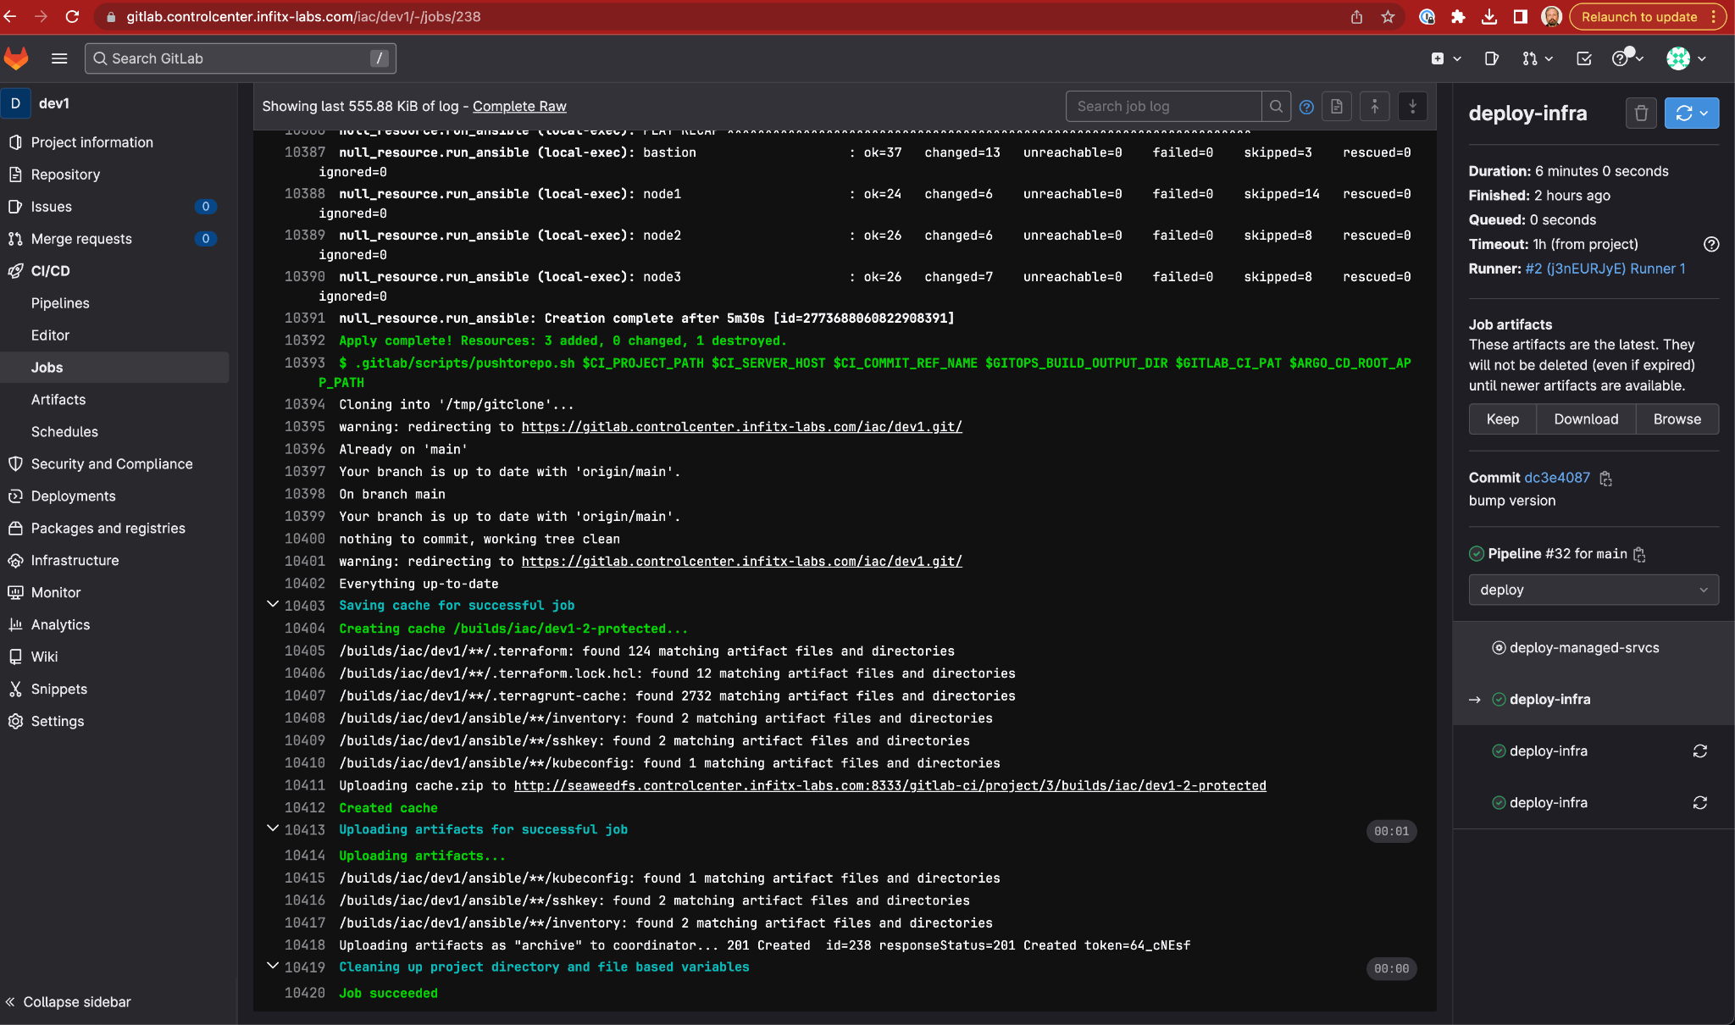

Slide 13
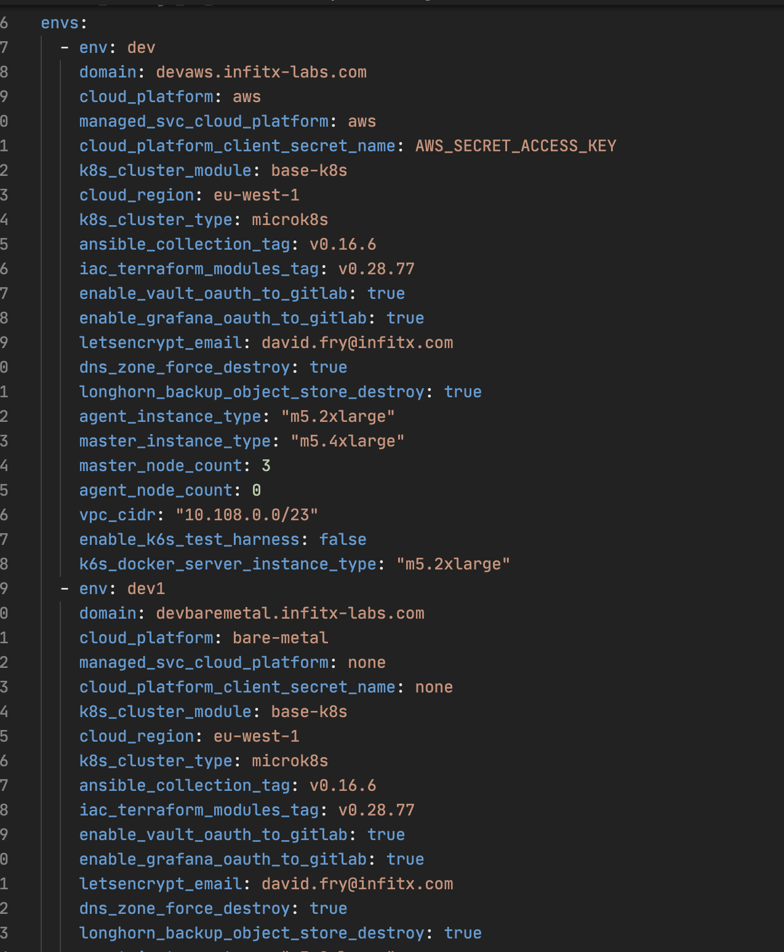

Slide 14
Reach out to participate
Email: david.fry@infitx.com
Mojaloop Slack: @David Fry
https://github.com/mojaloop/iac-modules
https://github.com/mojaloop/iac-ansible-collection-roles

